Slide 1



Creating Repositories and Collaborating with Git
Notes:
Adapted with <3 by Lindsey Berlin

Slide 2

Learning Objectives
(You Will Be Able To)
Initialize a new repository
Connect that new repo to GitHub
Create and switch between git branches
Implement a branching workflow
Avoid merge conflicts
Notes:
A note: students should be able to grab curriculum content and work on it locally after this lecture

Slide 3
Where We Left Off
Covered in ‘Introducing Git and GitHub’
What haven’t we covered?
Starting from an existing repository
Forking workflow
Pushing changes
Creating your own repo from scratch
Branching workflow
Merging changes
Notes:
This is the last real slide in the Introducing Git and GitHub

Slide 4

Initialize a New Repository
Initializing turns any local directory/folder into a local git repository.
git init
This creates a repository using ONLY Git, without involving GitHub at all.
Do not create a Git repository inside of another Git repository!
Use git status to check!
Notes:
Gif from Giphy
Demonstrate turning a folder into a git repository - using git status to check if the folder is already in a git repo, etc

Slide 5
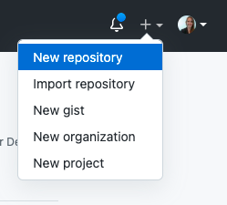
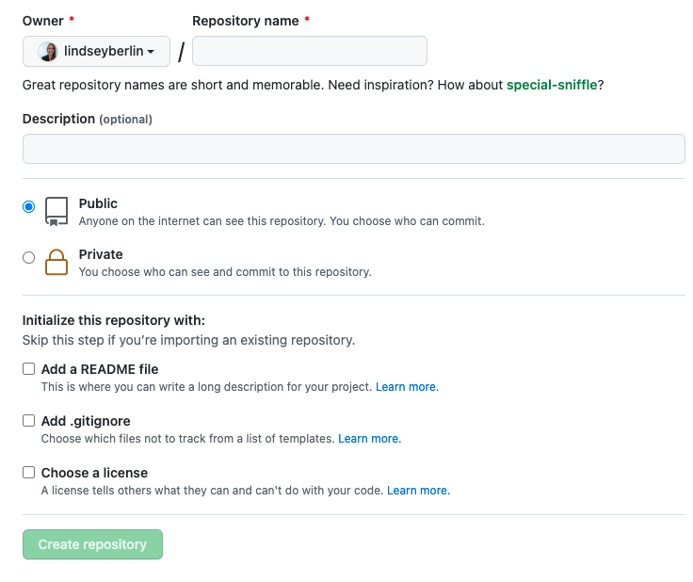
Connect a Local Repository to GitHub
1
Easy to create a new repository on GitHub.
Then:
Name your new repository (will become the URL)
Set permissions
READ CAREFULLY! If you already have an existing repository on your local computer (already ran git init in a folder with contents in it), make sure you DO NOT click any of the options!
2
3
Notes:
Demonstrate doing this - showcase how to think about descriptive URLs, discuss the reason you might add a description, then talk through when you should/shouldn’t check those boxes, being sure to emphasize that it’s easy to add these files later!
Talk through how you can also flip the script - start with a repo on GitHub (potentially checking those boxes), then clone that repo down onto your computer. Can demo, but should focus on this way of creating for now.

Slide 6
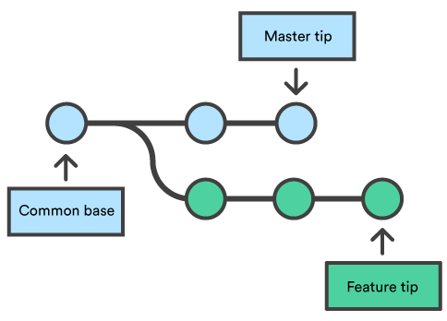
Git Branches
Branches allow you to do your own work based off a main ‘trunk’ of code, without disrupting other people working off that ‘trunk’.
Default branch name: main (or master)
git branch Check your branches
git branch [BRANCH] Create a new branch, named [BRANCH] - but won’t move you to that branch!
git checkout [BRANCH] Move to the branch named [BRANCH]
Notes:
Image source: https://www.atlassian.com/git/tutorials/using-branches/git-merge
Demonstrate these commands - should also show that git checkout -b [BRANCH] both creates a new branch and moves to it, and git branch -d [BRANCH] will delete a branch

Slide 7
Branching Workflow
Working Branch
Main Branch
Pull Request
Remote
A branching workflow is one common way to collaborate with others using GitHub.
One repository - many branches.
The Idea: code is written on a feature branch, then merged into the main branch via a pull request (a request to pull the content into main).
You will use this workflow for your projects!
git push origin [BRANCH]
git pull origin main
Local
git merge main
Notes:
Introduce this, but don’t need to walk through it just yet - you can do that if you run the guided git practice session (like on slide 9), or can discuss via the sample group project: https://github.com/flatiron-school/DS-Sample-Group-Project
Additional resource: https://www.atlassian.com/git/tutorials/comparing-workflows/feature-branch-workflow

Slide 8

Merge Branches
Merging allows you to bring changes together into one harmonious project . . .
HOW TO AVOID MERGE CONFLICTS:
Plan ahead and communicate
Work on different Jupyter notebooks
Use your own branch
Notes:
Gif from Giphy
Show an example of merging a branch back into main.
Notes for students: Don’t work in the same Jupyter notebook when working in groups. Just don’t. And, for group work, plan BEFORE YOU START how you’ll bring everything together at the end!
Additional resource: https://www.atlassian.com/git/tutorials/using-branches/git-merge

Slide 9

Time to Try It!

Slide 10

Any Questions?

